Slide 1


APPLICATION

Slide 2

What is UCAS?
All applications to universities for undergraduate degrees are made through UCAS.

Slide 3


Slide 4
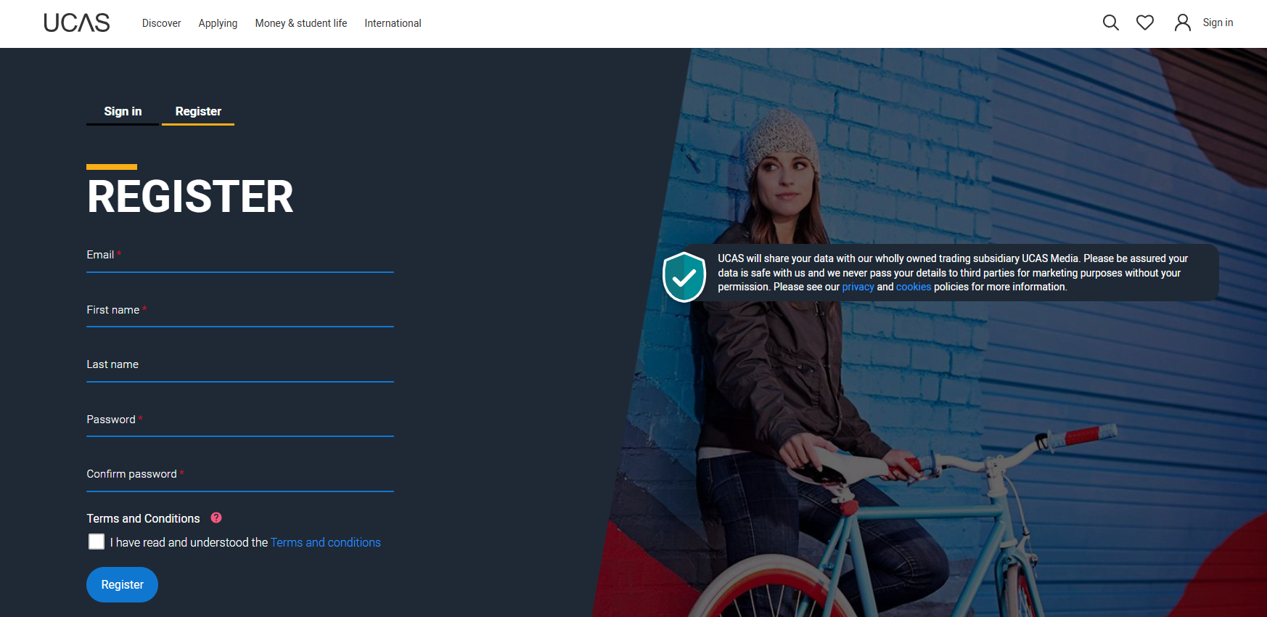
1. APPLY ONLINE

Slide 5
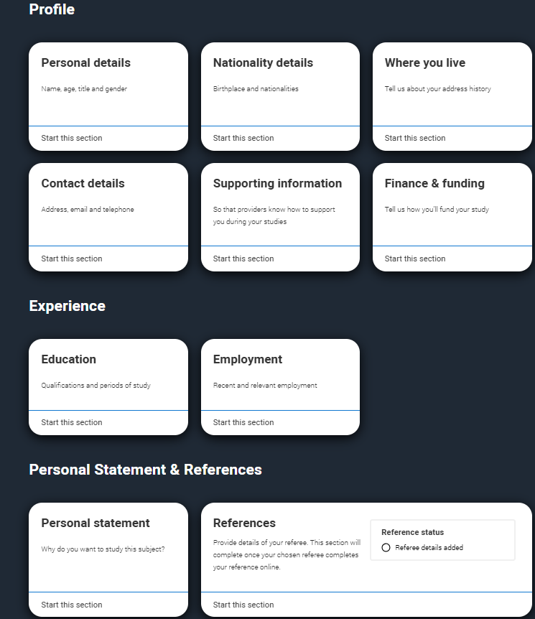
Students complete one online form filling in personal details, previous and current education, choices of universities and courses, and personal statement.

Slide 6
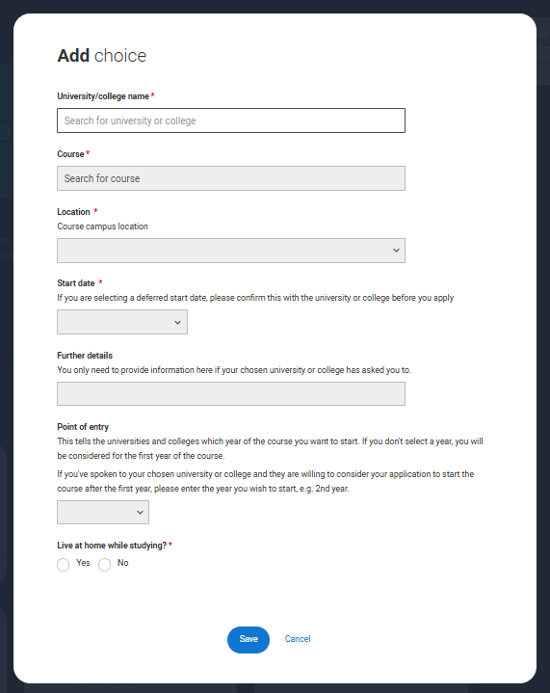
You can make up to 5 choices of universities.
There is no order of preference.

Slide 7

Once you complete the form, it comes to us to add our reference.
It then goes to UCAS and is sent out by UCAS to all of your chosen universities.

Slide 8
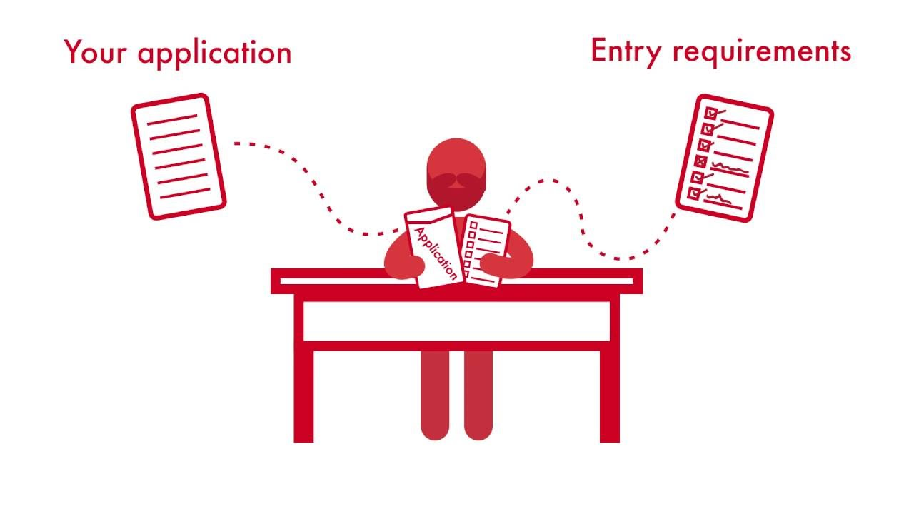
2. WAIT TO HEAR BACK
Universities will then reply to you. Some will reply quickly and others will take longer. Some universities may reject you but most will reply with conditional offers. The conditions will be your grade in this course and IELTS grade. You can keep up to date with the replies through UCAS Track.

Slide 9

3. REPLY TO YOUR OFFERS
Once you have heard back from all your choices, you must make a first choice (firm choice) and a second choice (insurance choice).
You will then reject your other offers.

Slide 10
4. FIND OUT IF YOU HAVE GOT YOUR PLACE
Then you do not have to do anything except to meet your conditions.
Once you have your foundation and IELTS result, IFG will send your results to the chosen universities.

Slide 11

GOOD LUCK!

