Slide 1


REGISTRATION

Slide 2

What is UCAS?
All applications to universities for undergraduate degrees are made through UCAS.

Slide 3

How to Register for UCAS?
Before you complete your UCAS form, you first have to register. This presentation shows you the different stages.

Slide 4
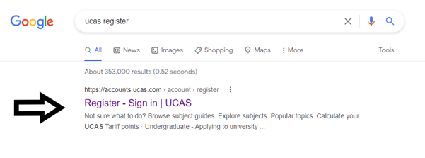


Slide 5
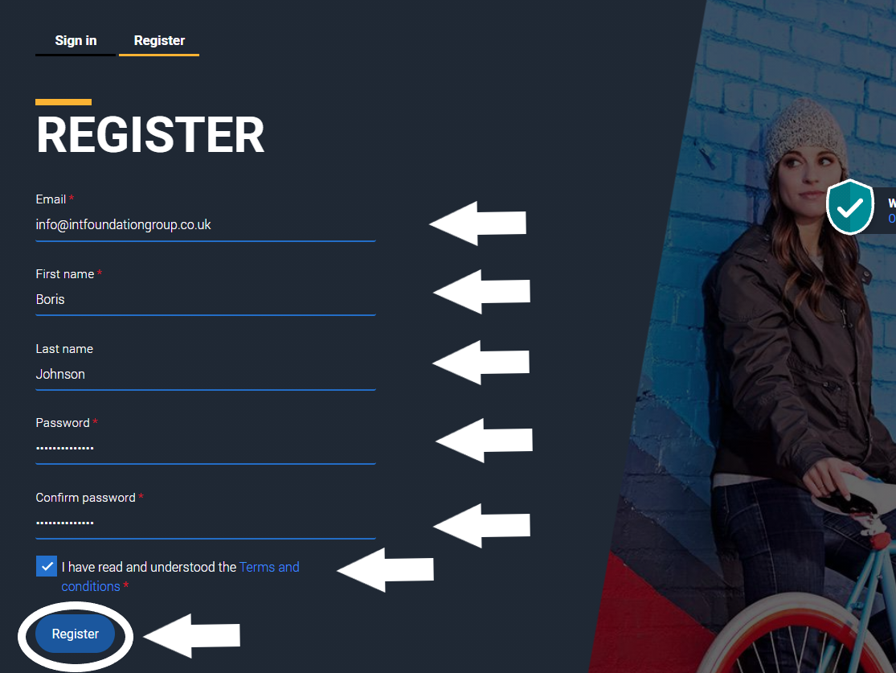

Slide 6
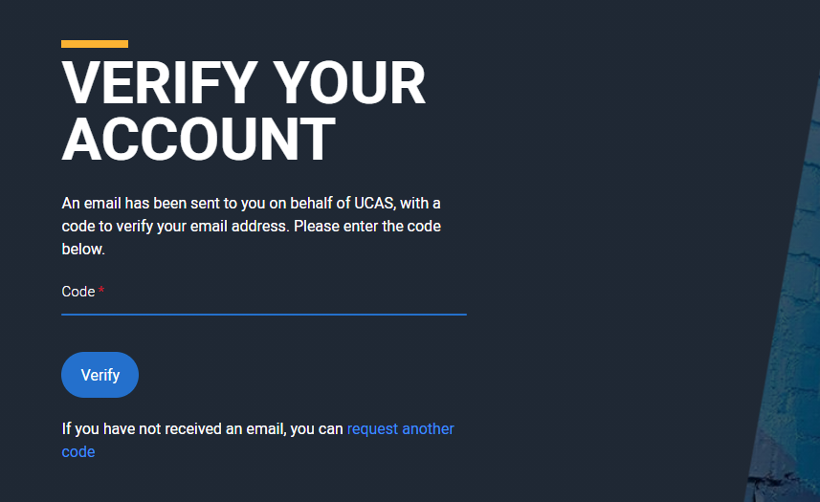

Slide 7
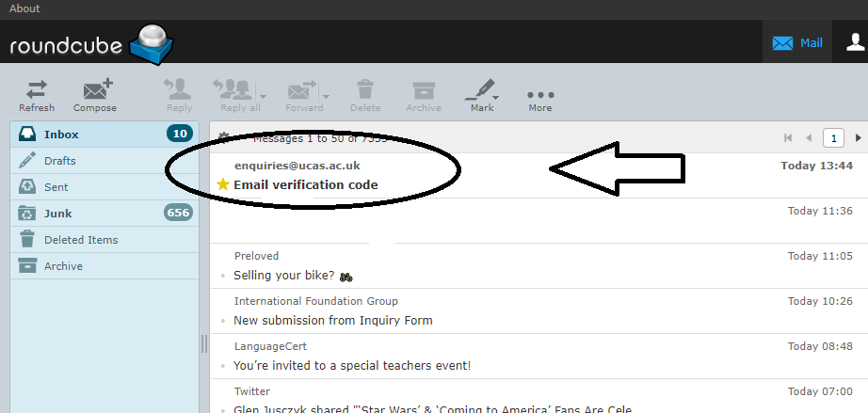

Slide 8
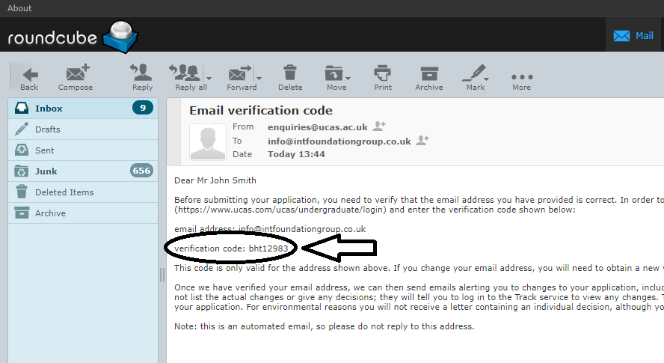

Slide 9
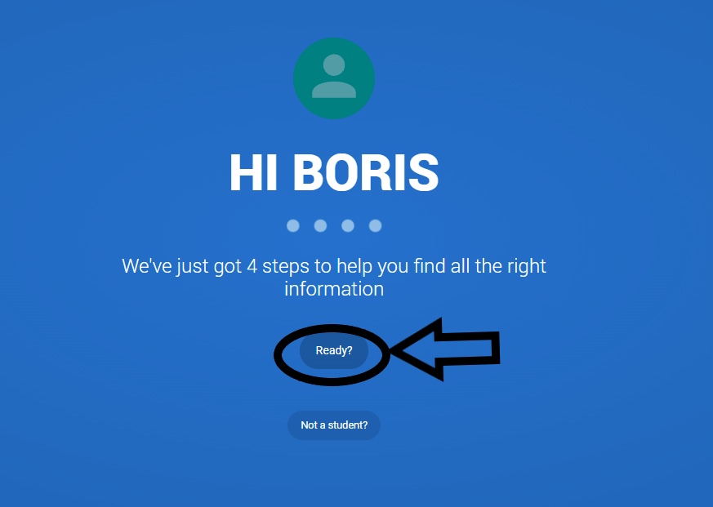

Slide 10
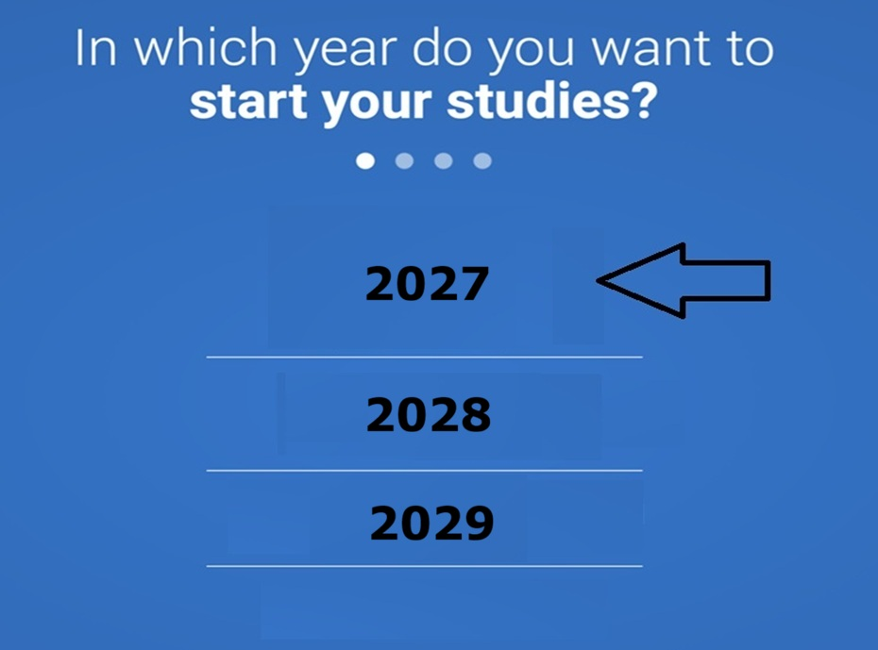

Slide 11
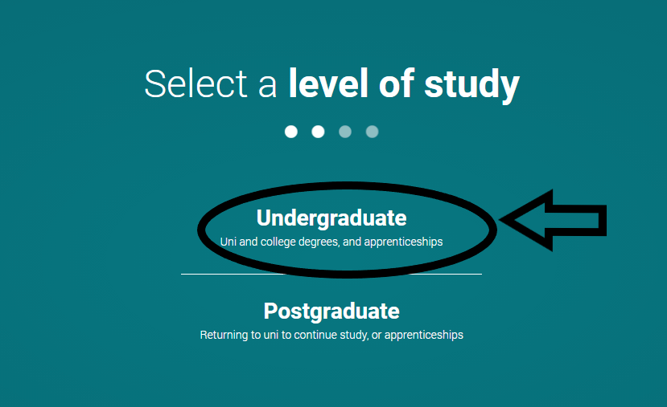

Slide 12
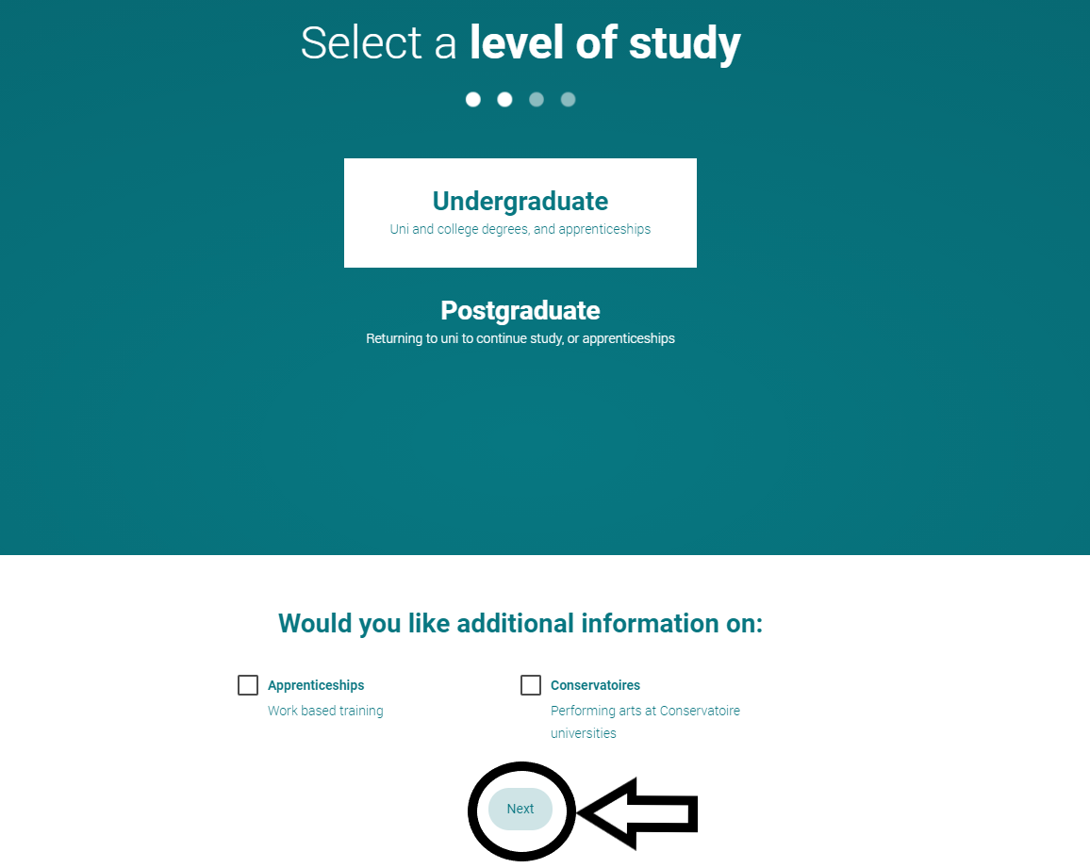

Slide 13
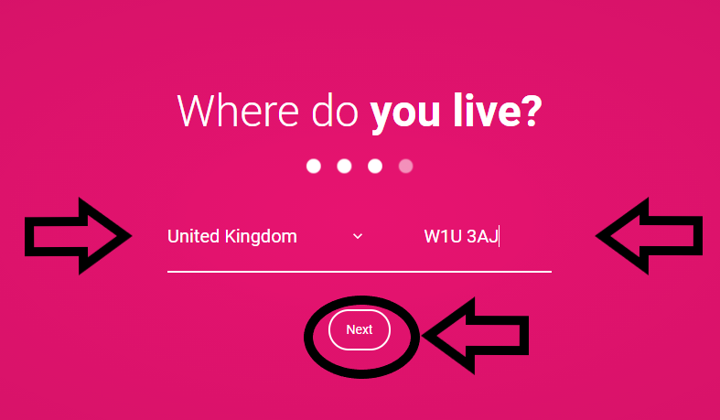

Slide 14
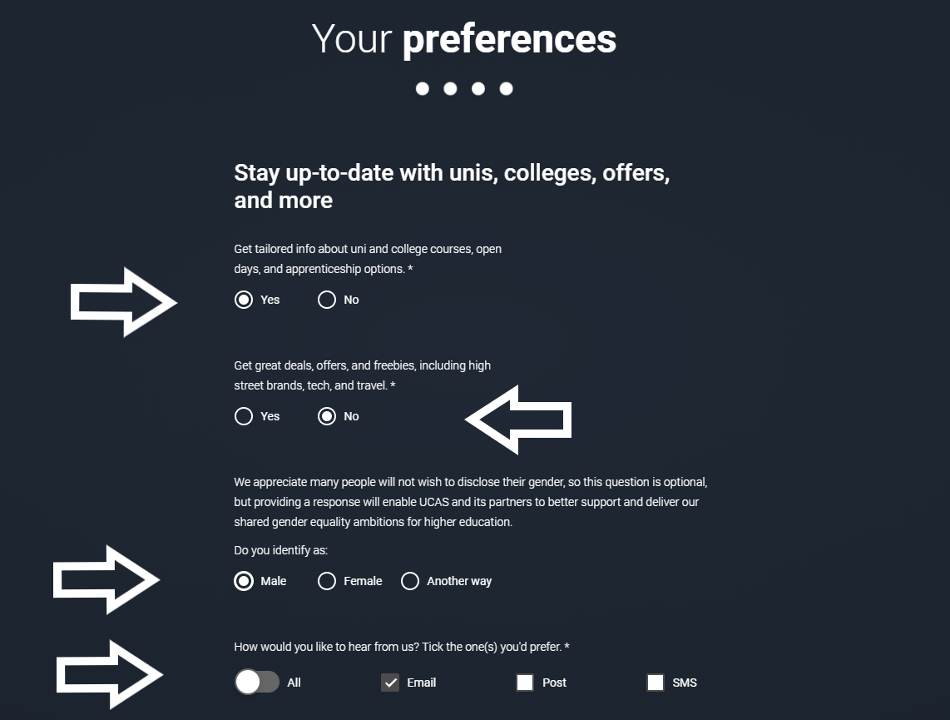

Slide 15
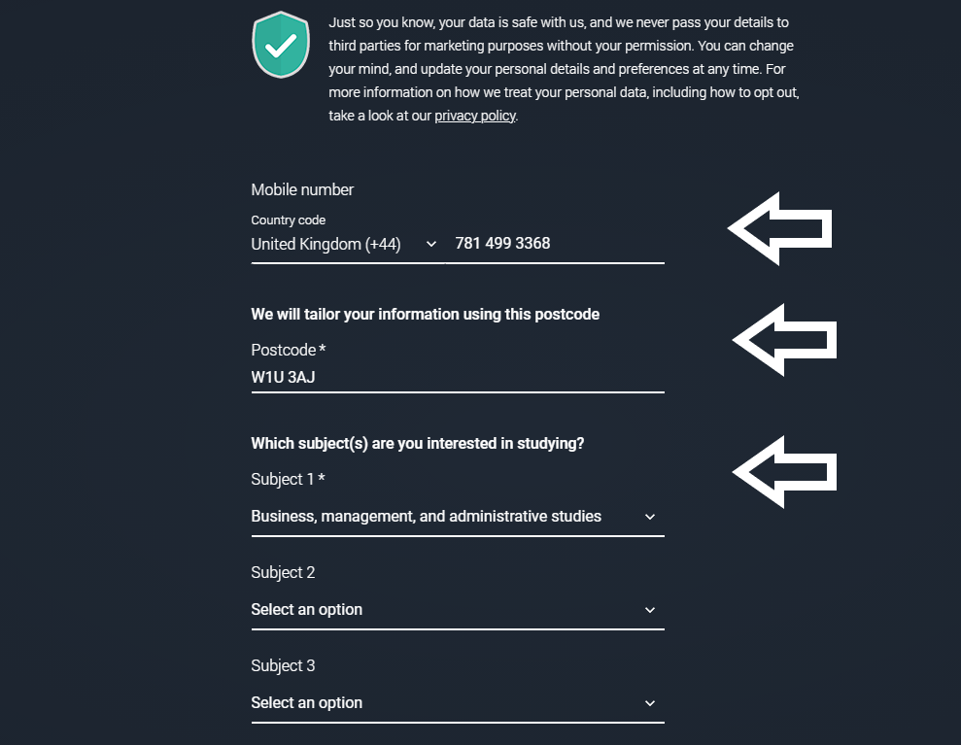

Slide 16
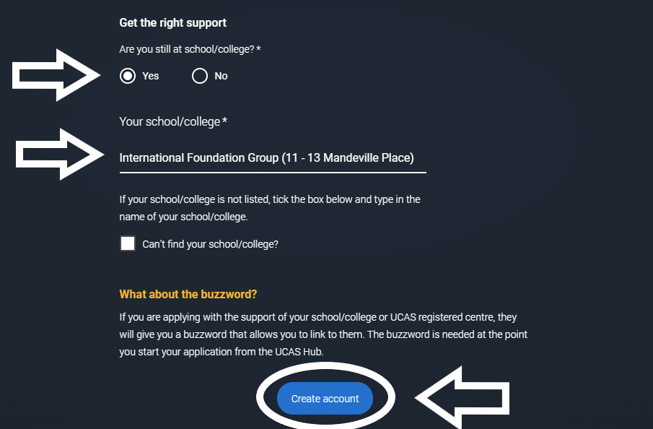
The College buzzword is:
IFG2027

Slide 17
