Slide 1
WELCOME TO IFG!

Slide 2
Thank you for choosing IFG
It’s up to us - and you - to make this year a success and to progress to university

Slide 3
TERM DATES
Semester One: 29th September – 12th December Reading week: 3rd November – 7th November
Semester Two: 5th January – 20th March
Reading week: 16th February – 20th February

Slide 4
COLLEGE LETTERS
As a student, you may require all or one of the following letters issued by the college:
• Bank letter (to open up a bank account)
• Council letter (to get Council Tax Exemptions on House Rent)
• Invitation letter for your family members to visit you
• Other relevant letters
Please email your request to info@intfoundationgroup.co.uk

Slide 5
OPENING BANK ACCOUNT
Opening a bank account in the UK - often quite a complicated process.
Another option - opening an online account. This account will allow you to transfer money into and out of the account, pay standing orders and direct debits and take out money from cash machines.
Please go to: https://monzo.com/sign-up for more details and to apply.

Slide 6
MEDICAL MATTERS
If you are on a short term study visa, you will get emergency treatment free of charge.
The nearest Accident & Emergency centre to our College is:
University College Hospital
235 Euston Road
London NW1 2BU
For other treatment, you will have to pay so we strongly advise you to take out medical insurance.
IFG has just signed an agreement with Howden Insurance. It gives medical and travel insurance to our students for six months for £162. IFG can arrange this for you.

Slide 7
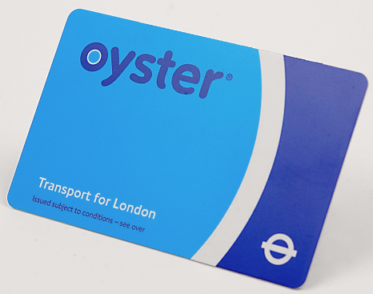
OYSTER CARD
Discounted fares on London underground and buses.
You will need to have a photo of yourself in jpg and a bank card to make the payment of £21.
Let us know that you have registered as we need to authorise the application.
Create account: https://photocard.tfl.gov.uk/tfl/showLogon.do?selection=student
Under 18’s: https://tfl.gov.uk/fares/free-and-discounted-travel/16-plus-zip-oyster-photocard

Slide 8
PHAROS
Our online library of resources for each of your modules.
Each module has a separate page on Pharos.
You will also use Pharos to upload your assessments.
Pharos is there to support your lessons and to help you to achieve high grades, so use it as much as possible.

Slide 9

VIRTUAL CLASSROOM
Use a laptop or computer, not your mobile phone
Make sure that you have working speaker, microphone and camera
Find a quiet room to sit in
Use Chrome or Firefox as your internet browser
For more information: https://www.intfoundationgroup.co.uk/pharos/

Slide 10
RECOMMENDED READING & PERLEGO
Reading list for each course will be sent to you
There are a lot of learning resources on our learning platform, Pharos.
Most books are available to download from our online library, Perlego.

Slide 11

PERSONAL TUTORS
You will be allocated a personal tutor.
The tutor will assist in your personal and academic development throughout your time with us. You can consult her/him for any of your academic, personal and career matters.

Slide 12
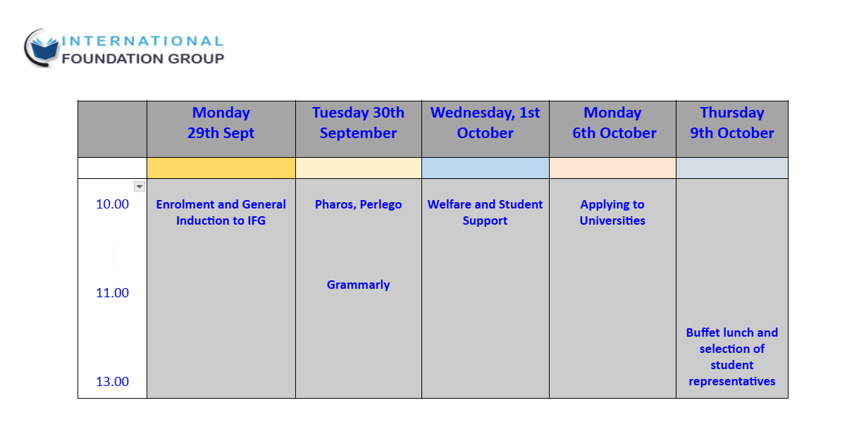
FURTHER INDUCTION MEETINGS IN LONDON

Slide 13
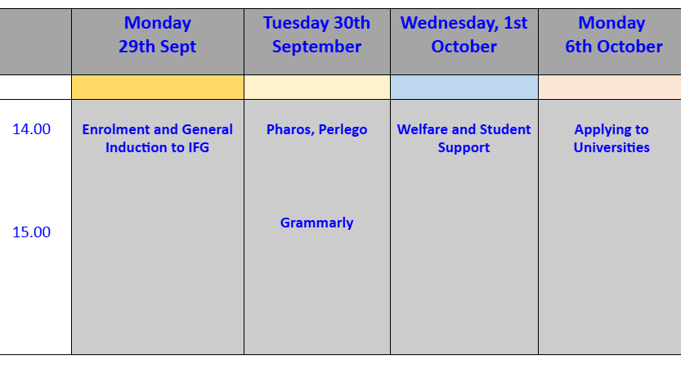
FURTHER INDUCTION MEETINGS ONLINE

Slide 14
APPLYING TO UNIVERSITY
You will receive extensive one to one help in choosing the right course and university for the next stage of your studies.
In the Study Skills module, you will receive advice on how to apply to different universities, and there is a wealth of material on Pharos to help you.
Students on the Foundation course must submit their applications before the end of the first term.
Postgraduate applications are usually not made until a little later but it is good to start thinking about your application as soon as possible.

Slide 15
DIFFERENT TYPES OF ASSESSMENTS
Exams
Coursework
Presentations
Group activity
Reflection
Posters
Research projects
Debates

Slide 16
AIMS OF OUR COURSES
Increase your knowledge of different topics
Develop your ability to evaluate and apply information
Become an independent learner

Slide 17
CONTACTS AND CONFIDENTIALITY
You will be given your own IFG email address and when teachers contact you, they will use this address.
All emails will forward to your private email address, so you do not have to login to your IFG account to read these emails.
It is up to you whether you reply from your private email or by logging in to your IFG account.
PLEASE CHECK YOUR EMAILS EVERY DAY (INCLUDING JUNK/SPAM FOLDERS)
PLEASE LET US KNOW IF YOU CHANGE YOUR ADDRESS, EMAIL ACCOUNT OR PHONE NUMBER.
One more please - when you send an email with an attachment, please put a small message with it!

Slide 18
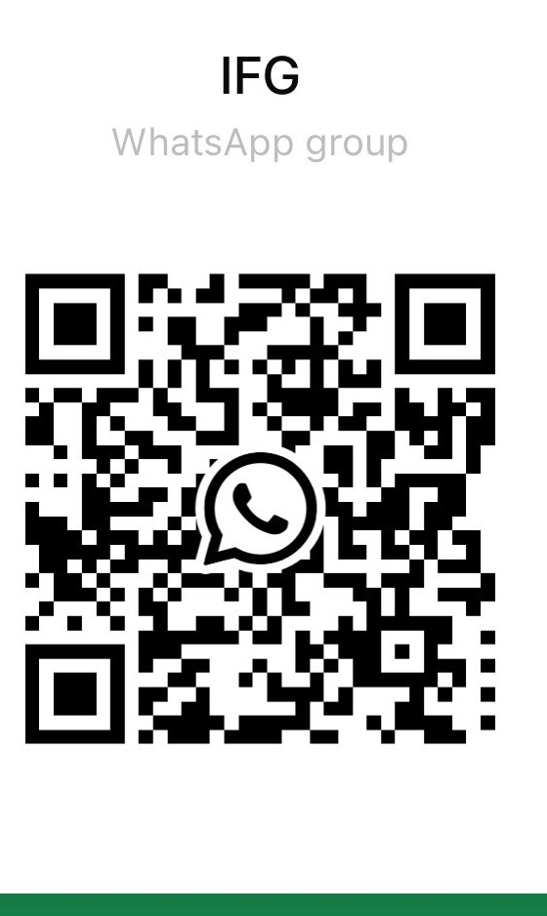
CONTACTS AND CONFIDENTIALITY: IFG COMMUNITY

Slide 19
ATTENDING LECTURES
Attendance of at least 85% of contact hours is required.
If not able to attend, contact us BEFORE the lesson at info@intfoundationgroup.co.uk
Appointments at banks or at your Embassy – not a valid reason for missing lessons! Your studies should come first and other things fitted around them.
Persistent lack of attendance will be reported and a meeting arranged with the Academic Director.
A note of your overall attendance percentage will sometimes be required by universities you apply to

Slide 20
PUNCTUALITY
Being late for classes is not only detrimental to the progress of the late comer, but also disruptive for the entire class. A student will be marked as Late if he/she arrives for class after the scheduled start time.
If a student arrives more than 10 minutes after the start, teachers may not allow you to join the class until after the mid lesson break.

Slide 21

CONDUCT
IFG aims to promote equal opportunity for all, and to ensure that no one is discriminated because of gender, race, ethnic origin, disability, nationality, colour, religion, political beliefs, age, sexual orientation, marital status, or family responsibilities. IFG places great emphasis on tolerance and respect and expects all staff and students to hold these values.

Slide 22
CONDUCT
If your behaviour, attendance record or academic standards are persistently below the standards required by the Code and are not resolved by informal discussion and negotiation, then disciplinary proceedings may be started against you. The disciplinary procedure is a formal process which applies to all learners enrolled with us.
More details will be given in our Student Support induction meeting

Slide 23
APPEALS & COMPLAINTS PROCEDURE
Students are encouraged to inform us if they feel that they have not been treated fairly or if they wish to comment on any aspect of College life at IFG. To make a complaint, please contact us on: info@intfoundationgroup.co.uk
Hopefully, complaints can be resolved on an informal basis. However students have the right to make a formal complaint and to appeal against any disciplinary action taken by the College.
Any complaints will be investigated during module preview meetings.

Slide 24

PROCEDURES IN THE EVENT OF A FIRE
On hearing the fire alarm, leave the building immediately by the nearest available exit (including fire exit doors). Go to the fire assembly point to the left of the front of the building at the crossroads of Mandeville Place and Hinde Street.
Leave your possessions in the classroom and do not use the lifts.
Do not re-enter the premises until told by the controlling officer to do so.
More details are on Pharos - Your first week at IFG

Slide 25
EMERGENCIES
In the case of extreme emergencies, you can ring our 24 hour emergency numbers:
07814 993368 (general) or
07939 885893 (for under 18s).
Please note that this service is for emergencies only which cannot wait until the next College day.

Slide 26
FIRST AID
IFG has trained First Aiders who can be called if there is an injury. First aid boxes are kept at reception.
Should you need assistance, please contact a member of staff, or Reception:
Michael 07814 993368/0203 633 0510
Maggie 020 3287 1443

Slide 27

STUDENT COUNSELLING & WELLBEING
We are committed to helping with these problems wherever possible so please do not suffer in silence but come and talk to us. To arrange an appointment, please either contact your personal tutor or, if you prefer, get in touch with the Academic Director (m.addison@intfoundationgroup.co.uk) or the Administrator on admin@intfoundationgroup.co.uk
All IFG students also have a free access to . This is an online and confidential community where you can access help and advice from trained professionals. You can also communicate anonymously with other students who may be experiencing similar problems. This is a 24/7 service.

Slide 28
STUDENT ENGAGEMENT
We encourage student engagement in all aspects of College life:
student representatives
student feedback on all academic and non-academic issues

Slide 29
STUDENT HANDBOOK
More detailed information available in our Student Handbook:
https://www.intfoundationgroup.co.uk/student-handbook/

Slide 30
DOCUMENTS WE WILL SEND TO YOU OR YOU CAN ACCESS ON PHAROS
Your timetable will be sent to you by email
Information sheet with contact details and log in details
Enrolment and medical forms to complete and return to us - these can be downloaded from Pharos- “Your first week at IFG”: https://pharos.intfoundationgroup.co.uk/course/view.php?id=76
This presentation can also be downloaded from the same link
Calendar of induction sessions is available on the same link:
https://pharos.intfoundationgroup.co.uk/course/view.php?id=76
There is one for London students, and one for online students
Recommended reading
Please send your email address and Whatsapp number to info@intfoundationgroup.co.uk now

Slide 31
THANK YOU FOR YOUR ATTENTION!
QUESTIONS?
COMMENTS?

